Slide 1

GIS-MO Project
CRAB

Slide 2
CRAB Mission
The mission of the Washington State County Road Administration Board (CRAB) is to preserve and enhance the transportation infrastructure of Washington Counties by providing standards of good practice, fair administration of funding programs, visionary leadership, and integrated, progressive, and professional technical services.
RCW 36.78.070 (4) Advise counties on issues relating to county roads and the safe and efficient movement of people and goods over county roads and assist counties in developing uniform and efficient transportation-related information technology resources;

Slide 3
GIS-Mo is Replacing mobility
Mobility
  Desktop Application
  In House Development
  Not Mobile
  NO GIS
Retiring application, but migrating data

Slide 4
County road assets
40k miles of county roads
120k culverts
3400 bridges >= 20 feet
2000 miles of guardrail
300k Sign Posts
Street Lights, Traffic Signals, Storm Systems, Curb Ramps, etc.
asset quantities are estimates only!

Slide 5
Target zero

Slide 7
Funding
Washington Traffic Safety Commission
Washington Association of Counties

Slide 8
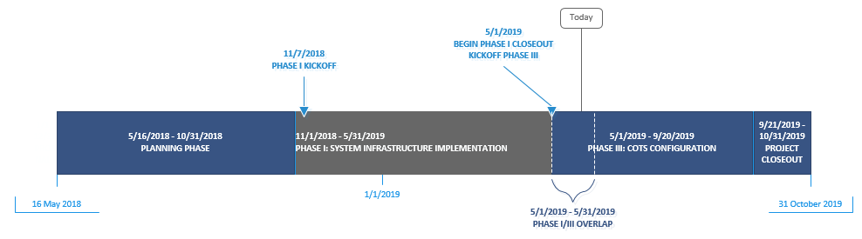
Initial configuration

Slide 9
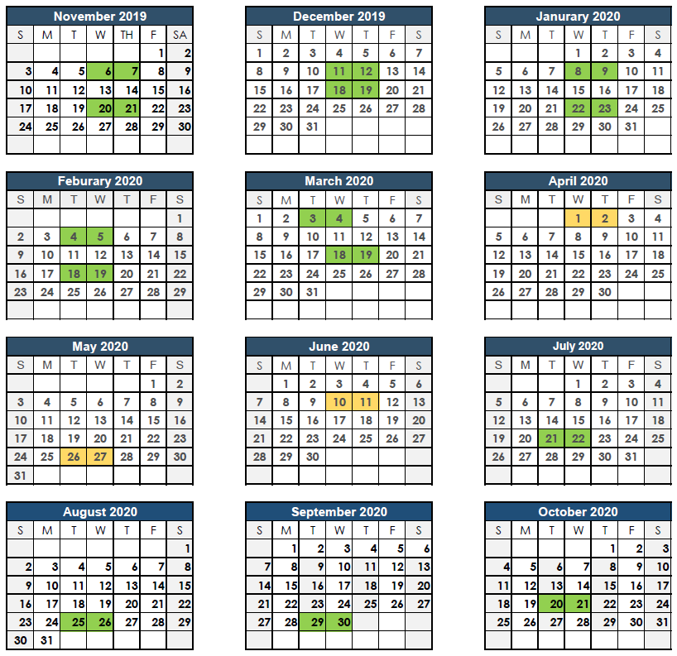
training
Physical Classroom
Virtual Classroom

Slide 10





Upload Tool
Event Editor
VUEWorks
CRAB Database
Mobile Apps

Slide 11
VUEWorks
Strategic Asset Management
VUEWorks
Track condition, depreciation & value
Prioritize consequences of failure
Forecast capital budget needs
Create & manage capital projects
Work Management
Document & track citizen issues
Create & track work orders
Manage time & expenses for labor & equipment
Manage quantity & expenses for inventory
Map & Data Sharing
Web browser based
View maps and data
Manage users
Search & report
Display & manage layers
List and edit attributes
Link documents & data
Manage facilities

Slide 12
Upload Tool
Maintain Data County Side
Upload to CRAB with Data Validation
Increased Data Sharing
Increased Data Completeness
Demo Tool
Upload Tool

Slide 13
Event Editor
Roads and Highways for County User
Editing To and From milepost
Editing Road Log Attributes
Visualize Tabular Data
Licensing, Additional Licensing
Portal for ArcGIS
Event Editor

Slide 14



Mobile Apps
Collect Data on the Go
Offline Editing
Maintain Work Orders
Create Condition Assessments
Mobile Apps
Collector App
ESRI Based
Requires County Customization
MobileVue
DTS VUEWorks
Maintained by CRAB

Slide 15
Singular DataBase
Access to the Database
All Tools Point To CRABS Database
Data Uniformity
Quality State Level Reporting
Counties Wont Report Twice!
CRAB Database

Slide 16
Data Integration
The GIS-Mo infrastructure can handle connecting to a different database
Maintenance Dist.
Legal Districts
Tax Zones
RID’s
ArcServer REST Services!

Slide 17
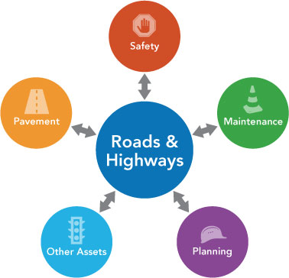
Less Work
More Agile/Responsive to Changes to Database
CRAB Validation and Reporting
  Visual validation
  Reporting Validation
WSDOT Reporting (they report spatially)
  HPMS
  MIRE FDE (all public roads required by 2026)
All of the tables will have required fields to
directly report to State and Federal agencies

Slide 18
Next steps
Integration/Interoperability Workgroup
  To date: 19 counties with 31 members
Complete Initial Configuration
Train County Staff
Migrate Data from Mobility

Slide 19

How many questions do you have?

